Slide 1
Introduction to BAIT2113 Web Application Development
Week 1

Slide 2
Google Classsroom
Lecture Classroom code: vwwspze
Practical Classroom code: Get from your tutor
Notes:
‹#›

Slide 3
Learning Outcomes
Apply the concepts and issues in server-side Web Application
Demonstrate skills in create, debug, optimize and maintain a secured Web Application with appropriate tools
User server-side Web Application development to solve contemporary business problems

Slide 4
Assessment
Component | Contribution
Coursework | 70%
Final Exam | 30%
 | Coursework Assessment | Due | Contribution
1 | Assignment Part I | Week 7 | 32%
2 | Assignment Part II | Week 12 | 48%
3 | Mid Term Test | Week 10 | 20%

Slide 5
Assignment (3-4 members)
Build a web site.
Part | Task | Due
Part 1 | Program coding | Week 7 practical
Part 2 | Program coding (extension from Part 1), presentation, and documentation. | Week 12 practical
You are advised to use the Microsoft Visual Studio 2019 or later to produce your work

Slide 6
Coursework mark
Make good is restricted.
Students who fail the Coursework will be required to REPEAT the course.

Slide 7
Introduction to Web Application
Chapter 1

Slide 8
What Are You Going To Learn?
At the end of this lesson, you will be able to:
Explain server-side
Differentiate between dynamic and static Web pages.
Explain the components in ASP.NET.
Study the .NET Framework.
Examine how ASP.NET works.
Create a simple ASP.NET page.

Slide 9
Static Web Pages
The content (text, images, hyperlinks, and so on) and appearance of static Web pages is always the same.
If you surf the Web, you'll see many static Web pages.

Slide 10
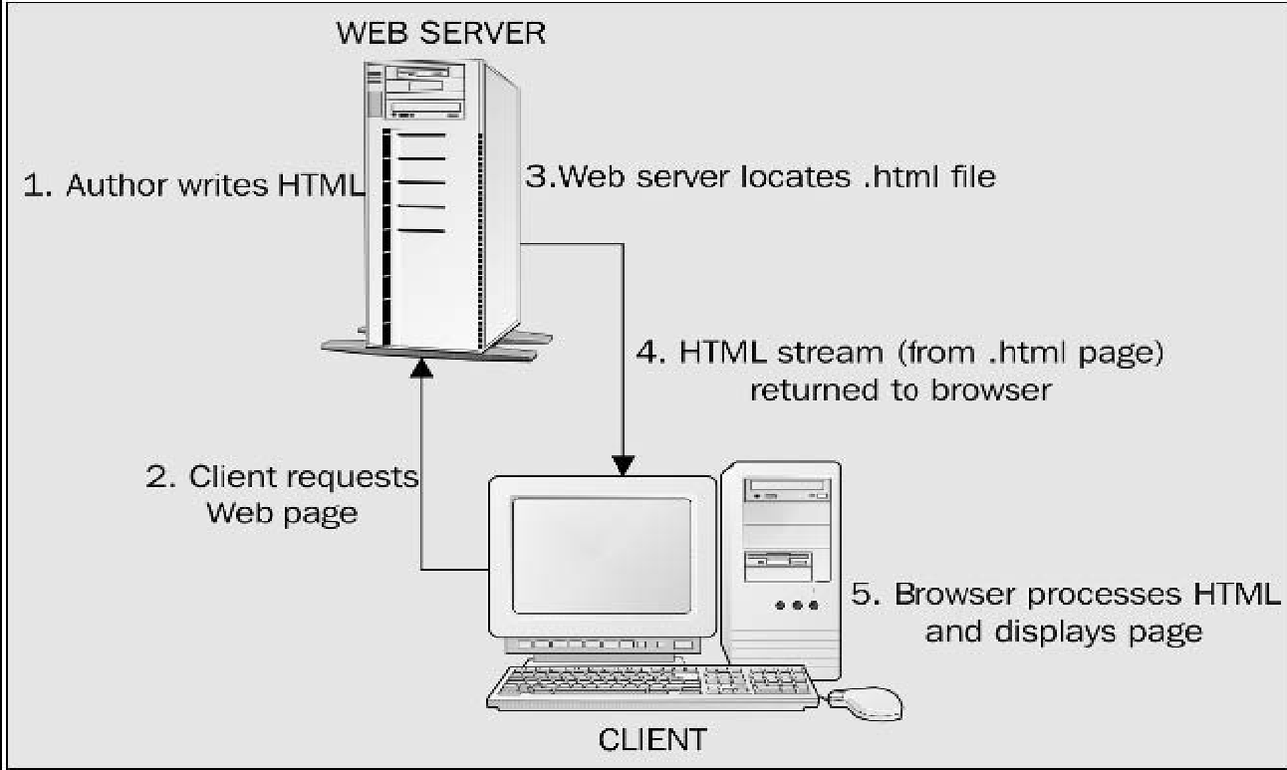
How Are Static Web Pages Served?

Slide 11
Static Web Page Example
<html>
<head>
<title>Example of Static Page</title>
</head>
<body>
<h2>Contact Me</h2>
Tel: 03-41450123
</body>
</html>
What is the output if you run this code today and tomorrow?

Slide 12
Limitations of Static Web Pages
Advantage:
FAST (as file size is small).
Lower cost.
Disadvantage:
Limited/No functionalities.
Hard to maintain content.
Notes:
‹#›

Slide 13
Dynamic Web Pages
The appearance of dynamic Web pages is generated dynamically at run time.
Thus the contents are not always the same.
Examples of the dynamic Website:
News site
Web applications such as E-mail service.
Etc.
Notes:
‹#›

Slide 14
Dynamic Web Pages
There are two ways in creating Dynamic Web Pages:
Client-Side Dynamic Web Pages
Server-Side Dynamic Web Pages

Slide 15
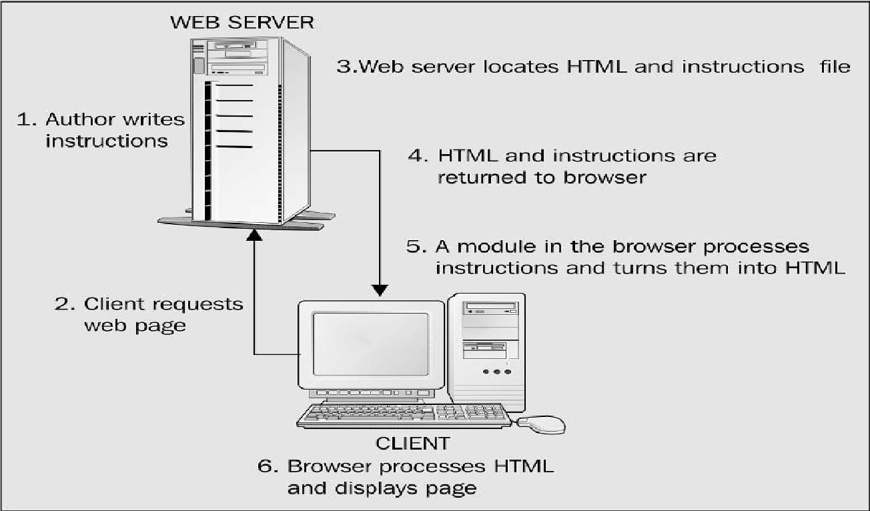
Client-Side Dynamic Web Pages

Slide 16
Client-side Dynamic Web Page Example
<!DOCTYPE html>
<html>
<head><title>Client-side Dynamic Web Page</title></head>
<body> <script> document.write(Date()); </script>
</body>
</html>
What is the output if you run this code today and tomorrow?
Notes:
‹#›

Slide 17
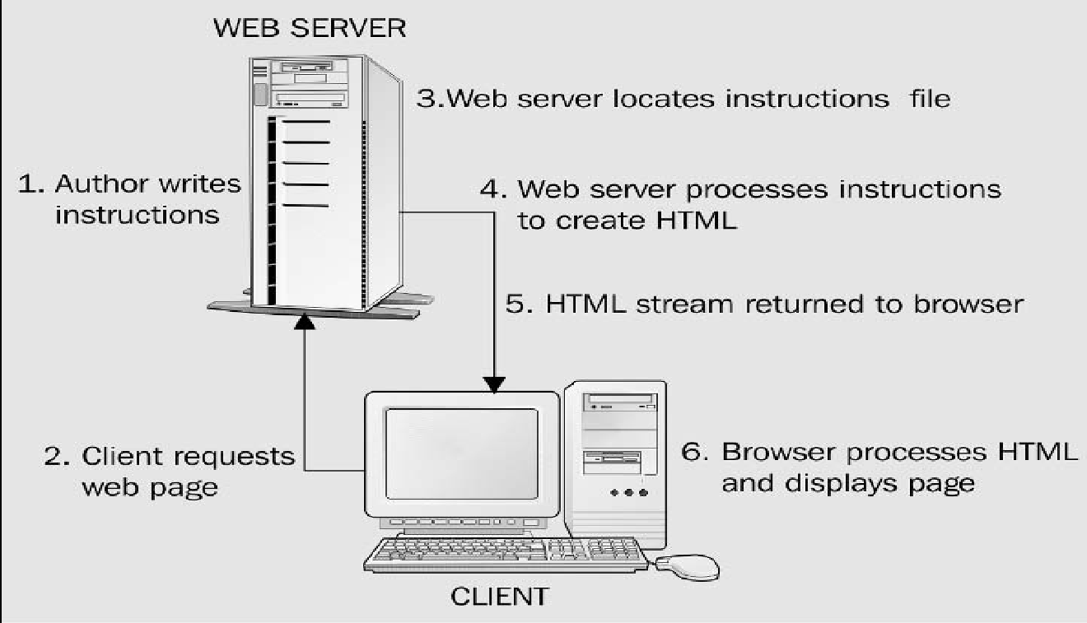
Server-Side Dynamic Web Pages

Slide 18
Server-side Dynamic Web Page
<!DOCTYPE html>
<html>
<head><title>Client-side Dynamic Web Page</title></head>
<body> <p>The time is @DateTime.Now</p>
</body>
</html>
ASP.NET Razor
What is the output if you run this code today and tomorrow?
Notes:
http://www.w3schools.com/aspnet/razor_intro.asp
Razor is a markup syntax that lets you embed server-based code (Visual Basic and C#) into web pages.
Development using web matrix – free download
‹#›

Slide 19
Differences between Client-side and Server-side Dynamic Pages
 | Client-side | Server-side
Effects created by | Browser | Server
Language(s) used | Javascript | .NET (C#, VB.NET), PHP, Python, …
Response speed | Faster | Slower
Server memory consumption | Low | High
Limitations | Limited functionalities | More complex features such as database access, and web services.
Notes:
‹#›

Slide 20
Case studies
Consider the following problem, which technology will you use, client-side or server-side?
To show a confirm dialog box before the user deletes an item.
To change a button’s image when user hovers the button.
To update the ticket balance after a user purchased a bus ticket online.
To display the status post to your online friends.
Notes:
‹#›

Slide 21
What is ASP.NET?
ASP.NET is a server-side technology (not programming language) for creating dynamic Web pages.
ASP.NET is a server-side technology that lets you use fully fledged programming languages to create your Web pages.

Slide 22
What is ASP.NET?
ASP.NET pages can be made from one of many languages.
ASP.NET is only one of a set of technologies that comprise the .NET Framework.
Typical languages supported natively are C#, J#, VB.NET. On top of this, it is expected that third party developers will create versions of Perl, Python, and many others to work in ASP.NET.

Slide 23
.NET Framework
A programming infrastructure created by Microsoft for building, deploying, and running applications and services that use .NET technologies, such as desktop applications and Web services.
To use .NET, you must install the .NET redistribution package (which is also installed with Visual Studio).
Evolved from version 1.0 to version 4.7 - as of this writing.
For Linux, equivalent is the Mono open-source project.

Slide 24
Introducing the .NET Framework
The .NET Framework is an integral Windows component for building and running the next generation of software applications and Web services.
The .NET Framework:
Supports over 60 different programming languages.
Enabling developers to focus on the core business logic code.
Makes it easier than ever before to build, deploy, and administer robust, and high-performing applications.
The .NET Framework is composed of the common language runtime and a unified set of class libraries.

Slide 25
Basic of .NET Framework
We can break down our discussion of the entire .NET Framework into several core concepts:
Common Intermediate Language (CIL)
Common Language Runtime (CLR)
.NET Framework class libraries
.NET languages
Windows forms
ASP.NET
Web services

Slide 26
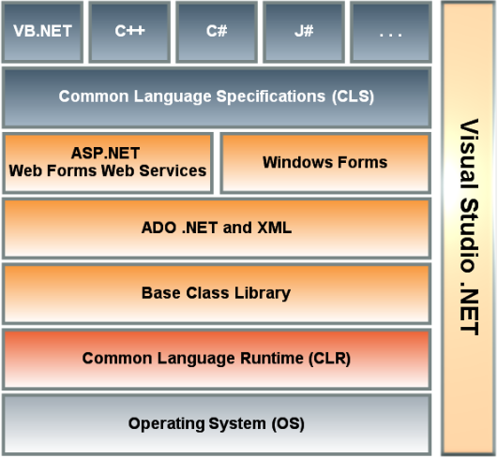
Features in .NET Framework
Notes:
CLS – e.g. CTS – VB= Boolean, J# - boolean, C# - bool, C++ - VARIANT_BOOL
Common Language Specification is a document that says how computers can be turn into MSIL (Microsoft Intermediate Language).
When several languages use the same bytecode, different parts of a program can be written in different languages.
https://www.youtube.com/watch?v=Cn1hFo7bs7A
By using ActiveX data object, it is a medium between the front end application and backend application, providing data access services so we can store our data in the SQL Server. XML is temporary data storage.
http://www.w3schools.com/asp/ado_ref_connection.asp
‹#›

Slide 27
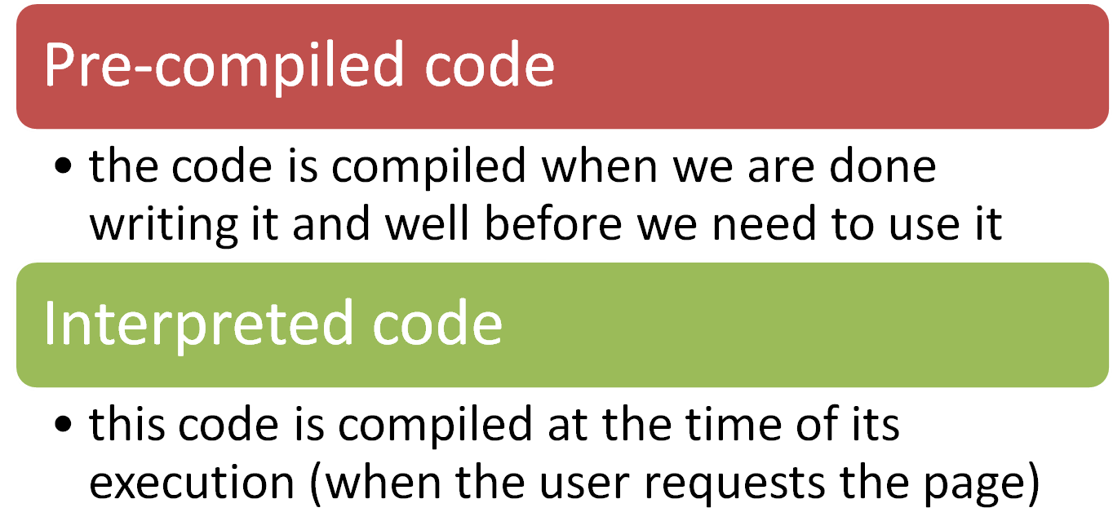
From Your Code to Machine Code
two types of compilation:
Notes:
‹#›

Slide 28
Question
What are the differences between pre-compiled code and interpreted code?
Notes:
‹#›

Slide 29
.NET Two-step Compilation
.NET solves the problem by using a two-step process for compilation.
Common Intermediate Language (CIL)
Common Language Runtime (CLR)

Slide 30
.NET Two-step Compilation
CIL and the CLR together give us the best of both worlds:
The structural optimization of pre-compiled code along with the portability of interpreted code.
We can therefore use all compliant languages interchangeably within our applications – allows different teams to work on the same Web site in different languages.
Notes:
‹#›

Slide 31
Common Language Runtime (CLR)
The CLR is responsible for executing your application code.
When you write an application for the .NET Framework with a language such as VB .NET or C#, your source code is never compiled directly into machine code.

Slide 32
Common Language Runtime (CLR)
Instead, the VB or C# compiler converts your code into a special language named:
CIL (Common Intermediate Language)

Slide 33
Common Language Runtime (CLR)
CIL looks very much like an object-oriented assembly language. However, unlike a typical assembly language, it is not CPU specific.
CIL is a low-level and platform-independent language.
When your application actually executes, the CIL code is "just-in-time" compiled into machine code by the JITTER (the Just-In-Time compiler).

Slide 34
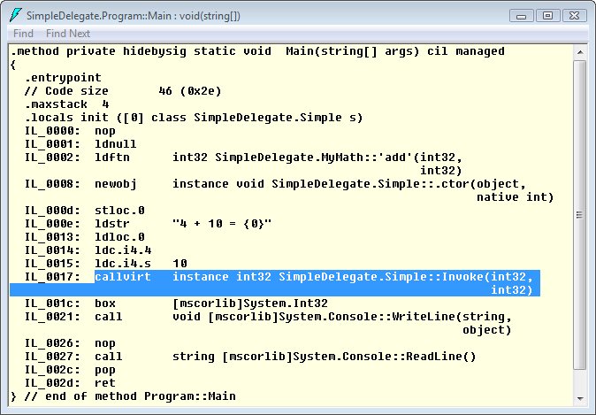
Common Language Runtime (CLR)

Slide 35
Common Language Runtime (CLR)
The entire application is not compiled from CIL into machine code. Instead, only the methods that are actually called during execution are compiled.
The .NET Framework understands only ONE language: CIL.
However, you can write applications using languages such as Visual Basic .NET and C# for the .NET Framework

Slide 36
Common Language Runtime (CLR)
Because the .NET Framework includes compilers for these languages that enable you to compile your code into CIL.
You can write code for the .NET Framework using any one of dozens of different languages, including
Ada, Apl, Caml, COBOL, Eiffel, Forth, Fortran, JavaScript, Oberon, PERL, Pascal, PHP, Python, RPG, Scheme, Small Talk,etc.

Slide 37
Compile into machine code
code
Application
Traditional Method (Compile to binary code)
Compile into
machine code
compile
code
CIL / MSIL
CLR
Application
In the .NET Framework
Notes:
‹#›

Slide 38
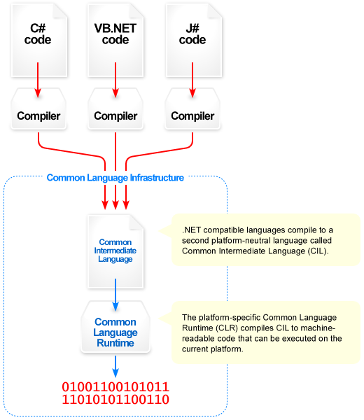
Notes:
https://www.youtube.com/watch?v=_PkugOSrxNU
‹#›

Slide 39
DEMO
Exploring Visual Studio IDE

Slide 40
What Is a Web Server?
Web servers are software that manage Web pages and make them available to client browsers – via a local network or over the Internet (two different machines or same machine).
While there are many Web servers available (e.g. Apache, Internet Information Services (IIS))

Slide 41
Hosting an ASP.NET Website
To test or run ASP.NET Web applications, you need a Web server
Internet Information Services (IIS): built into Windows OS but not enabled by default.
Visual Studio Development Server: comes with Visual Studio
Third-party such as UltiDev Cassini Web Server.
Notes:
‹#›

Slide 42
How ASP.NET Works
Think of ASP.NET pages as normal HTML pages that have sections marked up for special consideration.
When .NET is installed, the local IIS Web server is automatically configured to look out for files with the extension ASPX and to use the ASP.NET module (a file called aspnet_isapi.dll) to handle them.

Slide 43
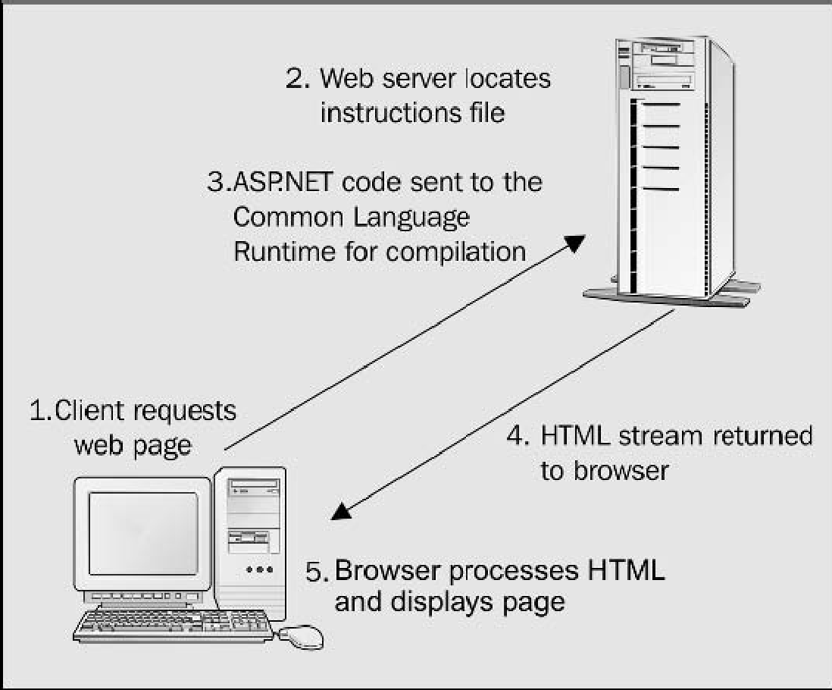
How ASP.NET Works

Slide 44
Creating First ASP.NET Web Page
Simple example
Creating a simple ASP.NET page by saving your ASP.NET file with an ASPX suffix.

Slide 45
What Have You Learnt?
Dynamic and Static Web Pages
Introducing the ASP.NET.
Introducing the .NET Framework
Exploring the Visual Studio 2017
Installing a Web Server
How ASP.NET Works
Creating Our First ASP.NET Web Page

